Slide 1

Speech Emotion Recognition with Combination of CNN-LSTM and DNN
Internship Training(EC 402)
Name: PONNA DINESH
Admission Number: U20EC009
Venue: Electronics and Communication Department
Duration: 01/01/2024 to 26/04/2024
Guided By:
Dr Suman Deb (Assistant Professor, DoECE)

Slide 2
OUTLINE
INTRODUCTION
OBJECTIVE
LITERATURE REVIEW
IMPLEMENTATION
RESULTS & DISCUSSION
CONCLUSION
REFERENCES

Slide 3
INTRODUCTION
Speech Emotion Recognition (SER) is a field within natural language processing that aims to detect emotions from spoken language.
It plays a crucial role in various applications such as human-computer interaction and sentiment analysis.

Slide 4
Applications of SER
Human-Computer Interaction
Health care
Education
Customer services
Market Research
Security

Slide 5
OBJECTIVE
Feature Extraction
Model Development
Model Evaluation
Comparative Analysis
Emotional Classifications
Optimization

Slide 6
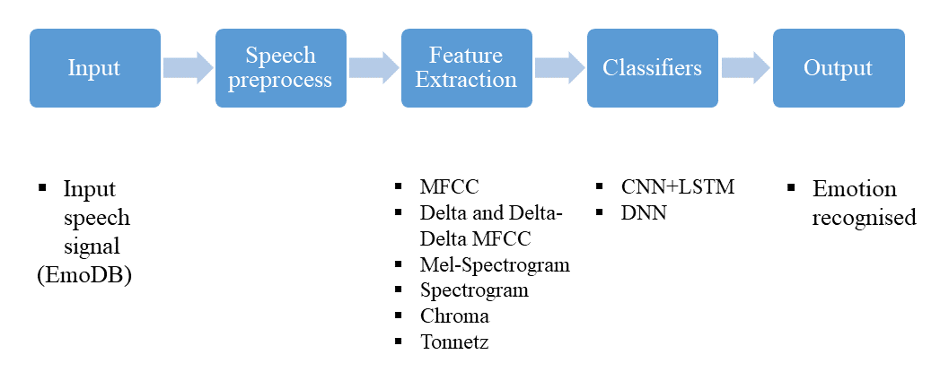
Methodology and Algorithm

Slide 7
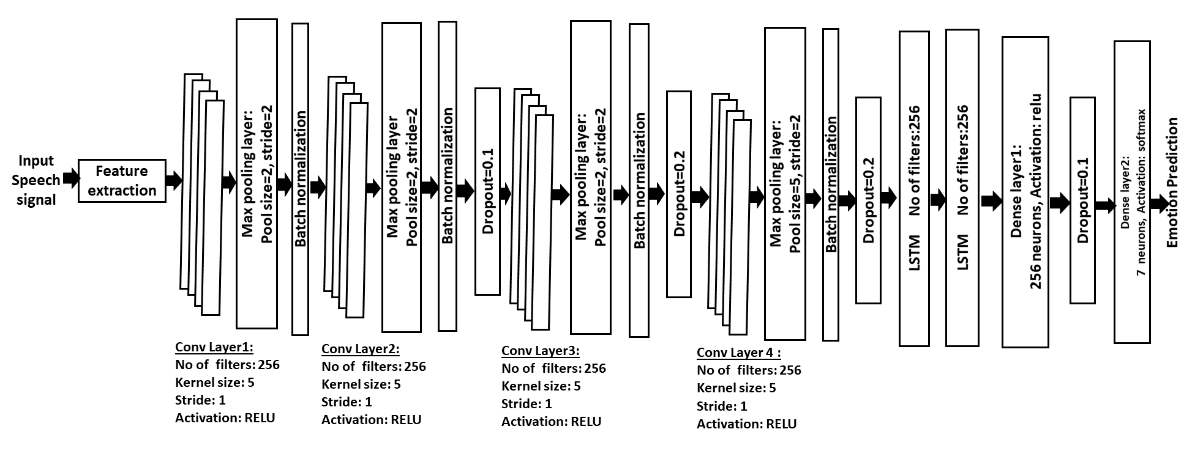
CNN-LSTM Architecture

Slide 8
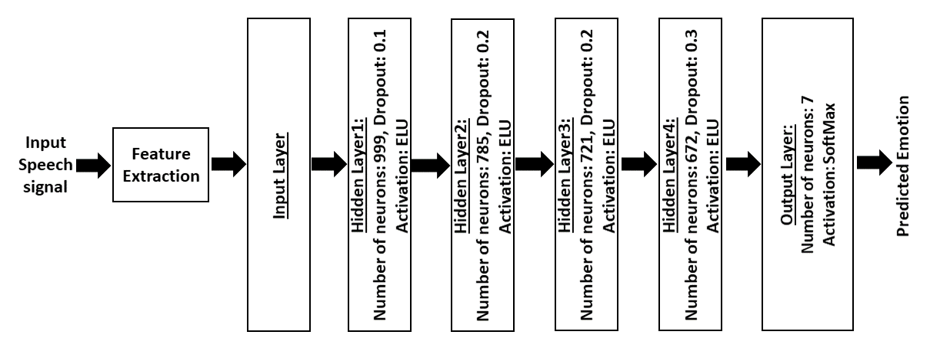
DNN Architecture

Slide 9
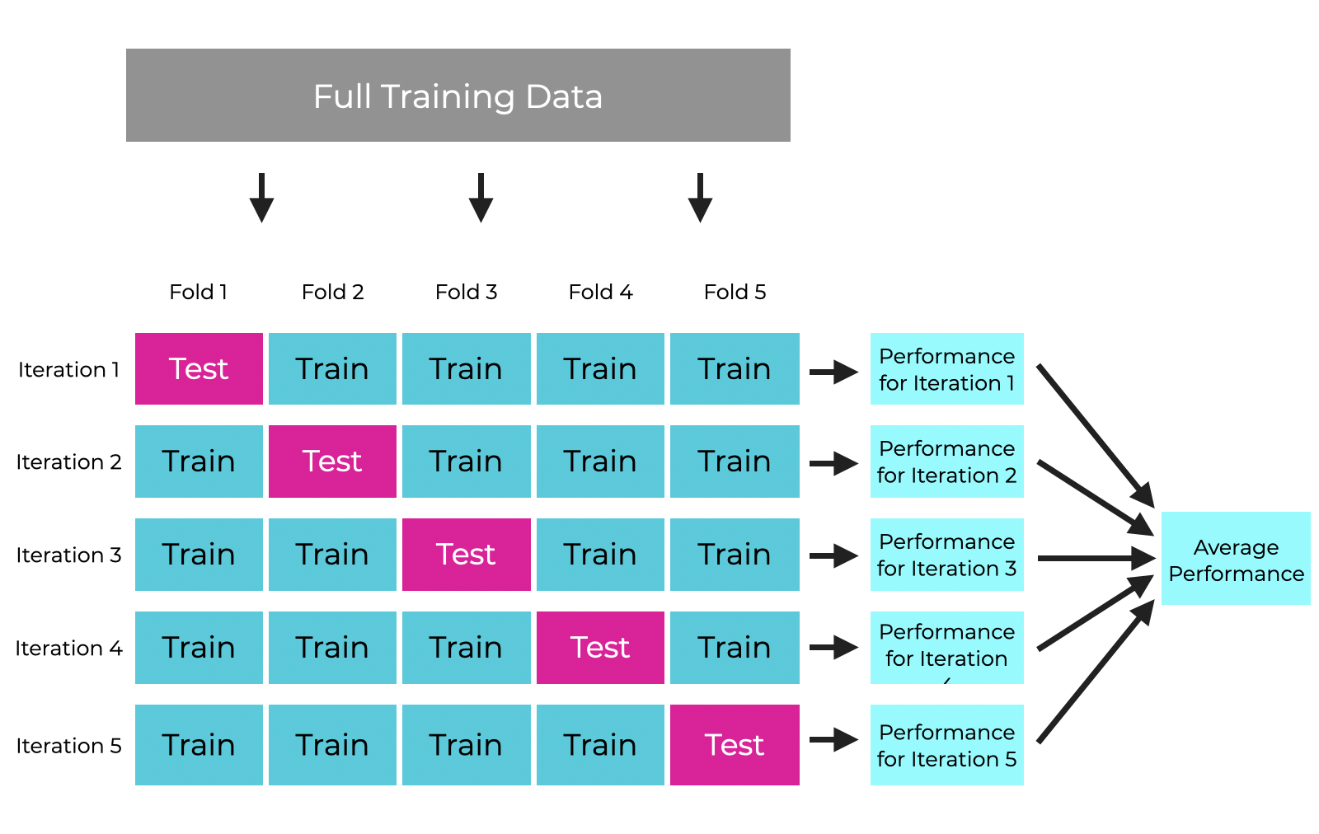
5-Fold cross-validation Strategy
Figure-4 : 5-fold cross-validation diagram

Slide 10
Results And Analysis
Using 5-Fold cross-validation strategy
Fold | Validation accuracy with CNN+LSTM in % | Validation accuracy with DNN in %
Fold-1 | 76.63 | 90.65
Fold-2 | 75.70 | 85.05
Fold-3 | 73.83 | 84.98
Fold-4 | 81.38 | 85.98
Fold-5 | 79.44 | 88.79
Average of 5-Folds | 77.38 | 87.09

Slide 11
Results And Analysis
Individual accuracies from train-test-split
Emotion | precision with CNN+LSTM model | precision with DNN model
anger | 0.80 | 0.94
boredom | 0.71 | 0.93
disgust | 0.80 | 0.91
fear | 0.80 | 0.82
happiness | 0.71 | 0.80
neutral | 0.73 | 0.79
sadness | 0.92 | 0.86

Slide 12
Conclusion & Future Scope

